Slide 1
Stock Analysis & Investment Portfolio
Capstone Project
Aditya G
Avinash J
Ashwin N

Slide 2
Content
Introduction
Database Introduction
Investor profiles
Key Insights
Portfolio Suggestions
Conclusion

Slide 3
Introduction
Our objective is to facilitate our clients in meeting their investment objectives with the best portfolio possible
Key points which have been considered:
Every stock in our database has been individually checked for current performance
We have relied on technical analysis techniques and KPIs to predict returns and risks of the market
We have referred to data from the last 5 years across multiple sectors and market index to have a reliable output

Slide 4
We have a database of 24 stocks, across sectors, to identify the most appropriate portfolio for both of our investors
Database Introduction
Aviation
American Airlines Group Inc
Finance
Barclays
Pharma & Healthcare
Johnson & Johnson
Technical
Allegiant Travel Company
Alaska Air Group Inc
Delta Air Lines Inc
Hawaiian Holdings Inc
Southwest Airlines Co
Credit Suisse
Deutsche Bank
Goldman Sachs
Morgan Stanley
Wells Fargo
Merck and CO inc.
Pfizer inc
UnitedHealthGroup Inc
Bausch Health Companies inc
Roche Holding AG
Apple Inc
Amazon
Facebook
Alphabet
IBM
Microsoft

Slide 5
Mr. Patrick Jyengar
Conservative Investor
Want to invest $500K
Expect to get $1000K in 5 years
Mr. Peter Jyengar
Prefers high return investments and accepts additional risk
Want to invest $1000K
Expect to get high returns in 5 years
Assumed to at least see 500% returns
Investor Profiles

Slide 6
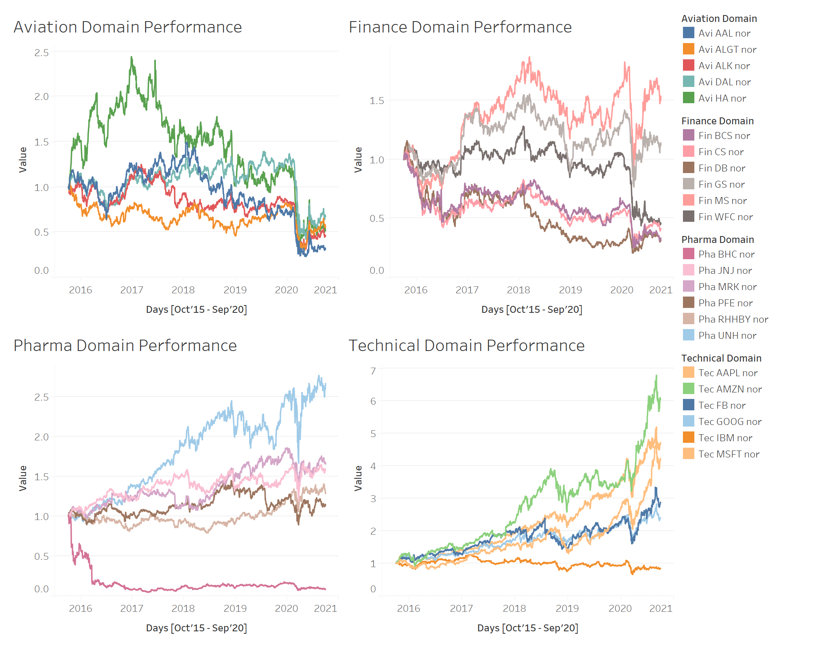
Observations
Since 2020, Aviation sector saw a major decline
Unquestionably, Covid restrictions impacted the travel industry
On the contrary, technical domain, which was already on the rise since 2018, grew exponentially since 2020
Pharma and Finance domain show an almost similar trend wherein there is a dip in 2020 initially but most companies covered the decline pretty fast
For investing, Technical domain is a must as it shows huge returns.
Pharma domain shows stability and Aviation shows the opportunity of getting back on track post the Covid period
Key Insights
[Domain Performance]

Slide 7
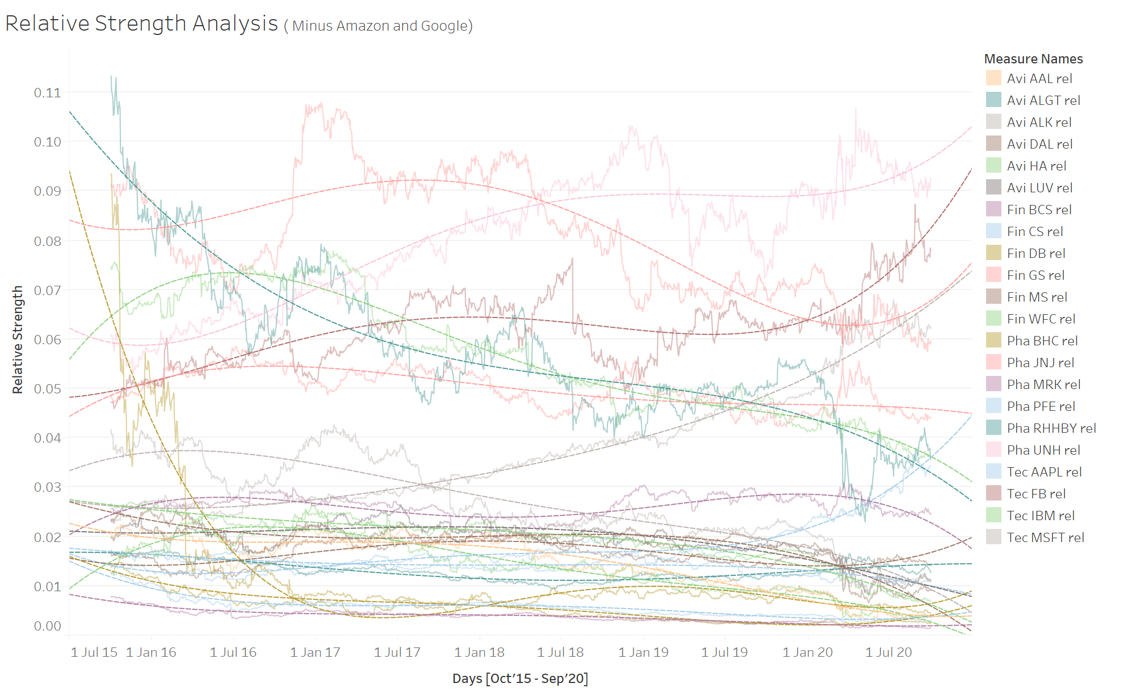
Observations
Relative strength provides an overview of stock performance compared to how the market is performing at the time
We have removed ‘Amazon’ and ‘Alphabet’ from this view as it impacts the scale too much
Within the other stocks, we can see a belt of average performers on the bottom which saw a slight decline but are now consistent
In the top half, some companies like IBM, ALGT have downgraded while technical firms like FB, Microsoft have picked up immensely
Key Insights
[Relative Strength]

Slide 8
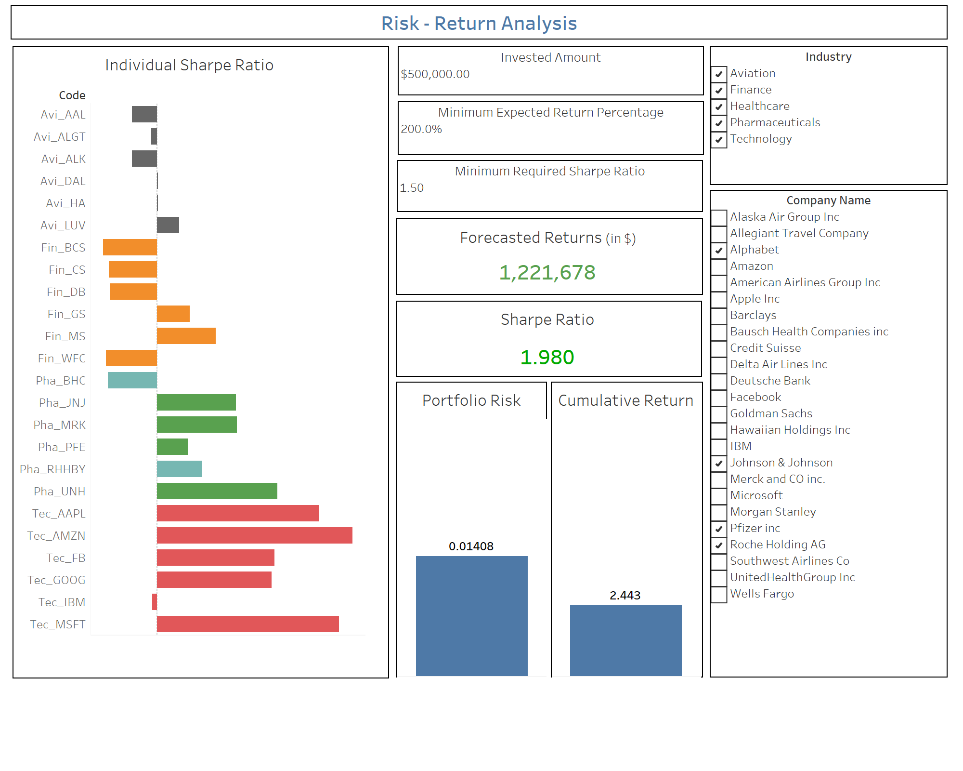
Description
With an investment amount of $500K, Mr. Patrick required to double the investment
For the portfolio selection, our focus was on choosing a portfolio with the least risk % but still satisfying the criteria
The selected companies are:
Alphabet (Google)
Johnson & Johnson
Pfizer Inc
Roche Holding AG
The risk on this portfolio is 1.4% while the net return is 1.4 times i.e. $720K
Portfolio Suggestion
[Mr. Patrick Jyengar]

Slide 9
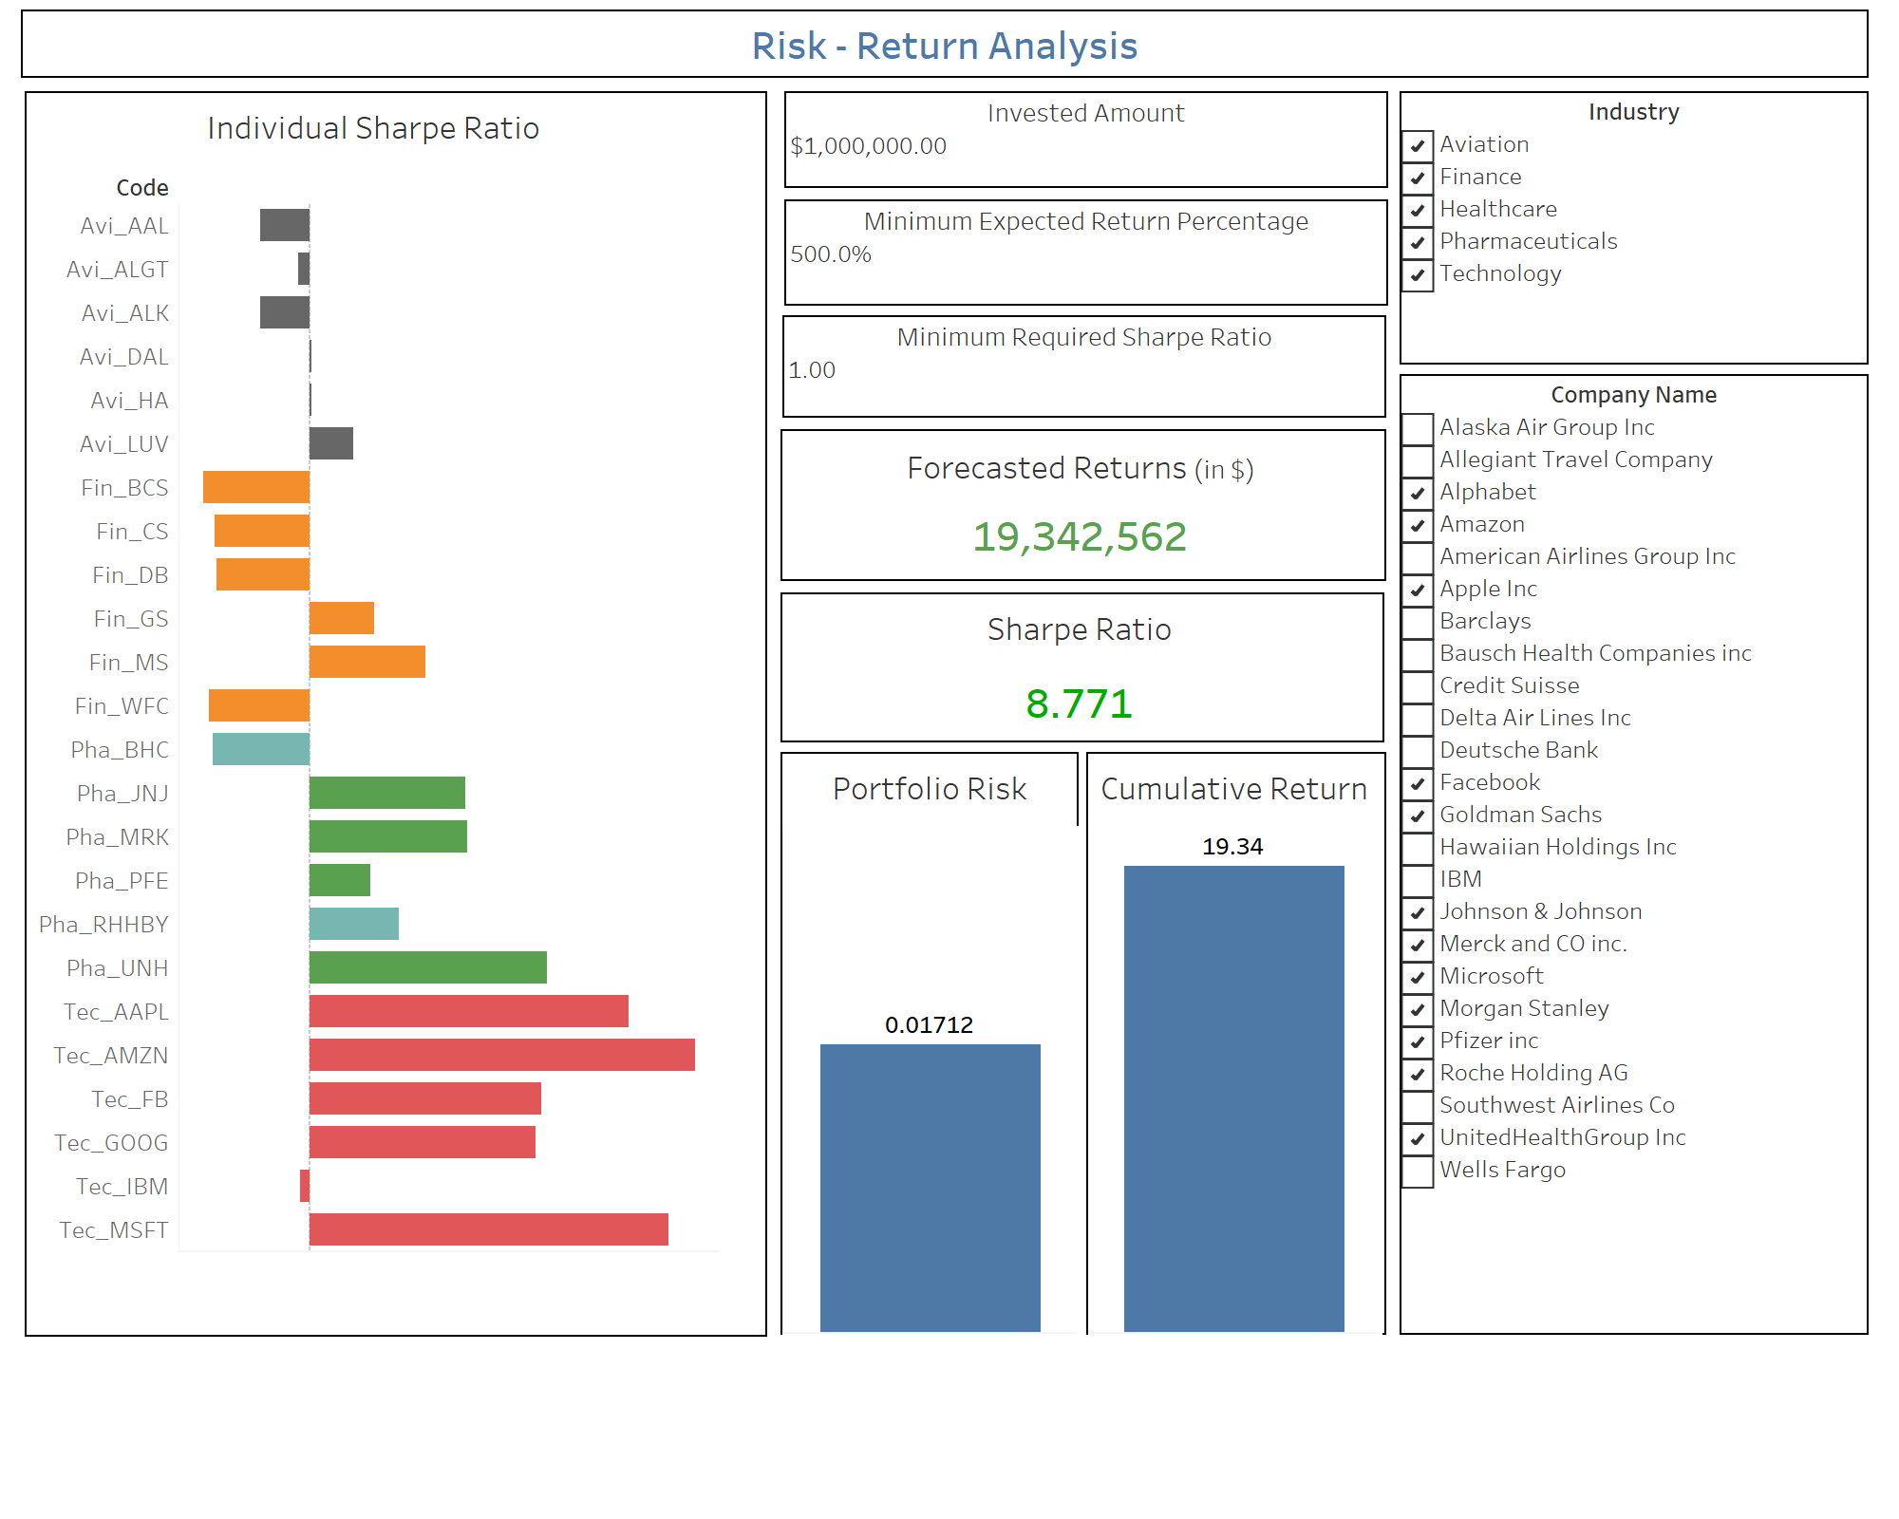
Description
With an investment amount of $1M, Mr. Peter wanted high returns
Our focus was on choosing a portfolio with the maximum returns but still having a value for risk
The selected companies are:
Alphabet (Google)
Amazon
Apple Inc
Facebook
Goldman Sachs
Johnson & Johnson
Merck and CO inc.
Microsoft
Morgan Stanley
Pfizer Inc
Roche Holding AG
UnitedHealthGroup Inc
The risk on this portfolio is 1.7% while the net return is 18.34 times i.e. $18.34M
Portfolio Suggestion
[Mr. Peter Jyengar]

Slide 10
Conclusion
Due to high growth in technical domain, the market is doing much better than expected
We would suggest Mr. Patrick Jyengar to consider revisiting his requirements as he could opt for much better returns with very limited increase in overall risk
That’s all from our side, Thank You!

